Slide 1

IBM Data Analyst Capstone Project
Vidhi solanki
Date:23/05/2026

Slide 2



OUTLINE
Executive Summary
Introduction
Methodology
Results
Visualisation – Charts
Dashboard
Programming Languages Trends
Discussion
Findings & Implications
Conclusion
Appendix

Slide 3

EXECUTIVE SUMMARY
Collected and analysed Stack Overflow Developer Survey data
python
pandas
POWER BI
Cleaned and processed the dataset using Python and pandas
Built dashboards to present insights effectively.

Slide 4

INTRODUCTION
The dataset contains responses from developers worldwide
The analysis focuses on programming languages, salaries, and work preferences
Python, Pandas, and visualization tools were used for analysis.
The goal is to identify trends and insights from developer data.
Data Cleaning
Dashboard Creation

Slide 5

METHODOLOGY
Data collection from survey dataset
Data cleaning using Pandas
Data analysis using Python
Data visualization using charts
Python
Power BI / Visualization Tools

Slide 6
RESULTS
Analysis identified popular programming languages
Salary trends were visualized
Developer preferences were analyzed
Charts and dashboards improved understanding of data

Slide 7
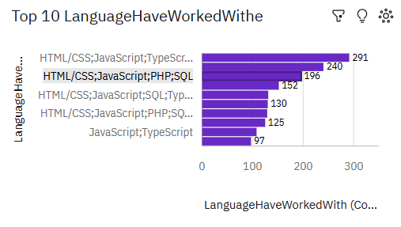
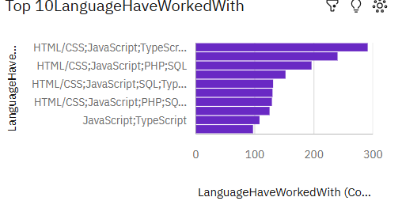
PROGRAMMING LANGUAGE TRENDS
Current Year
Next Year

Slide 8
PROGRAMMING LANGUAGE TRENDS - FINDINGS & IMPLICATIONS
Findings
JavaScript and Python are among the most popular languages
HTML/CSS and SQL are widely used technologies
Developers continue to use multiple programming languages
Implications
Learning Python and JavaScript improves career opportunities
Full-stack development skills are in high demand
Database knowledge is important for developers

Slide 9
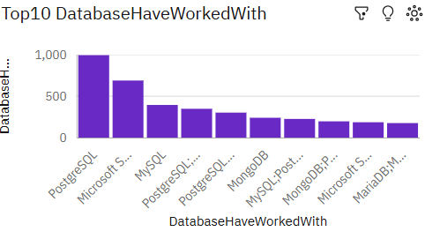
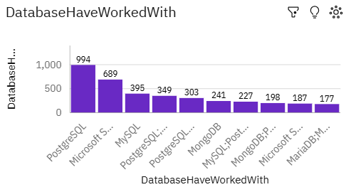
DATABASE TRENDS
Current Year
Next Year

Slide 10
DATABASE TRENDS - FINDINGS & IMPLICATIONS
Findings
PostgreSQL and MySQL are widely used databases
MongoDB is popular for modern applications
Microsoft SQL Server remains important in industry
Implications
Database management skills are highly valuable
SQL knowledge is essential for data-related roles
Cloud and NoSQL databases are growing rapidly

Slide 11

DASHBOARD
IBM Cognos Analytics Dashboard
Dashboard includes 3 tabs: Current Technology Usage, Future Technology Trend, and Demographics.

Slide 12
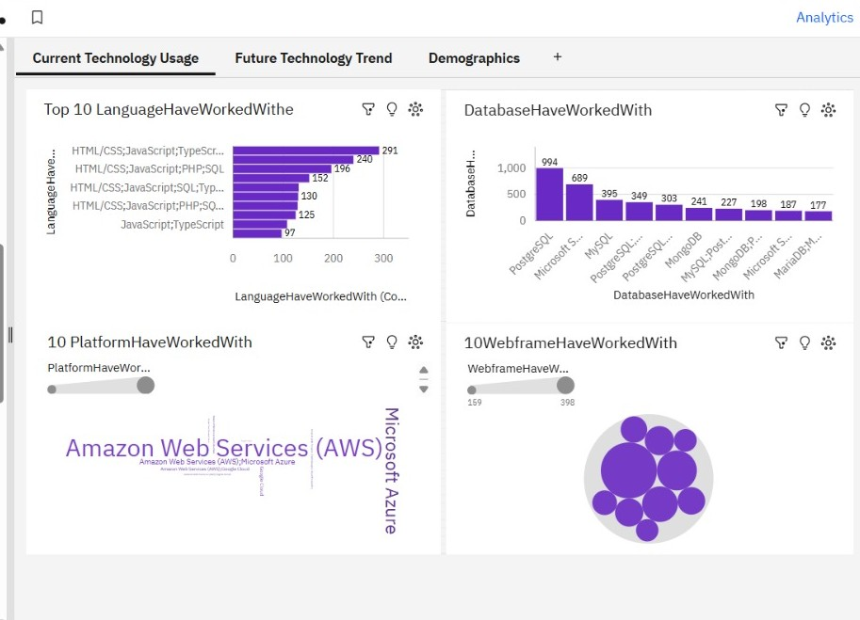
DASHBOARD TAB 1

Slide 13
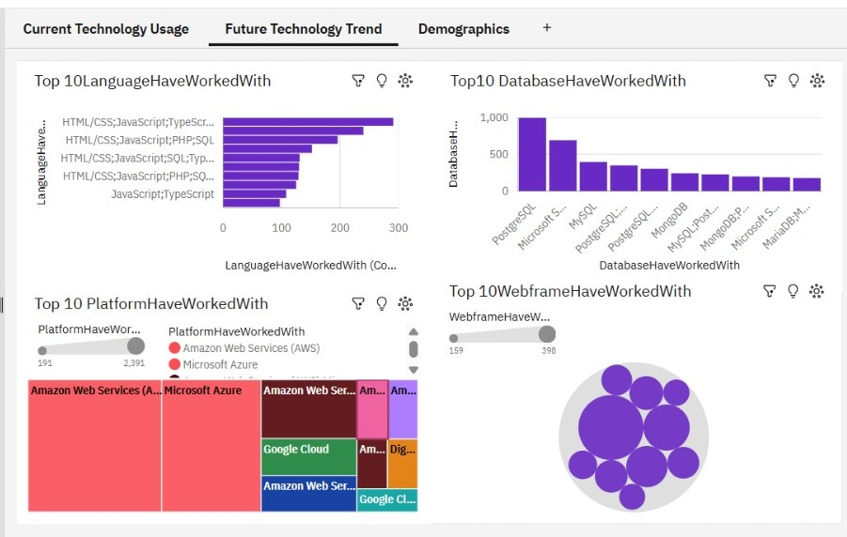
DASHBOARD TAB 2

Slide 14
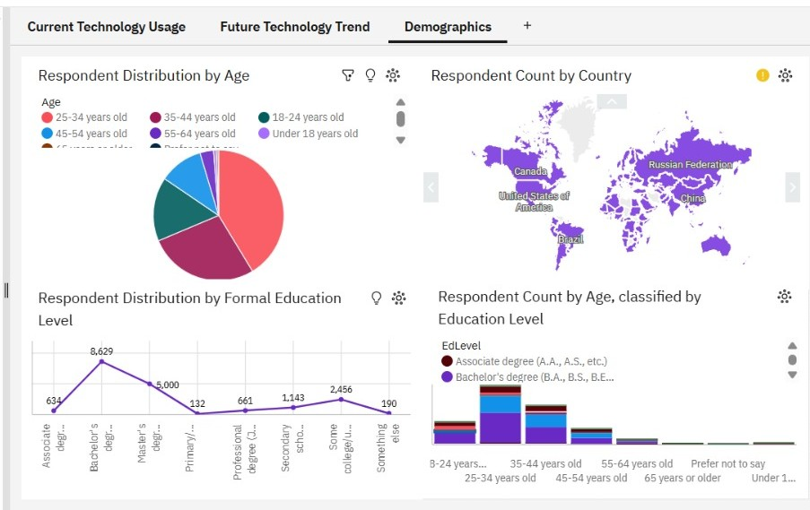
DASHBOARD TAB 3

Slide 15
DISCUSSION
Python and JavaScript are among the most popular technologies.
Database technologies remain important in software development.
Cloud platforms such as AWS are widely used.
Dashboards improve analysis and decision-making process.

Slide 16
OVERALL FINDINGS & IMPLICATIONS
Findings
Python and JavaScript are the most popular programming languages.
PostgreSQL and MySQL are widely used databases.
AWS and cloud technologies are growing rapidly.
Implications
Learning Python and JavaScript improves career opportunities.
Database knowledge is important for data-related roles.
Cloud computing skills are becoming essential in industry.

Slide 17

CONCLUSION
Python and JavaScript are leading technologies.
PostgreSQL and MySQL are highly preferred databases.
Cloud technologies like AWS are growing rapidly.
Data analytics helps in better business decision-making.

Slide 18

APPENDIX
Include any relevant additional charts, or tables that you may have created during the analysis phase.
Additional dashboard screenshots included.
Dataset used: Stack Overflow Developer Survey.
Tools used: Python, Pandas, Cognos Analytics.

Slide 19
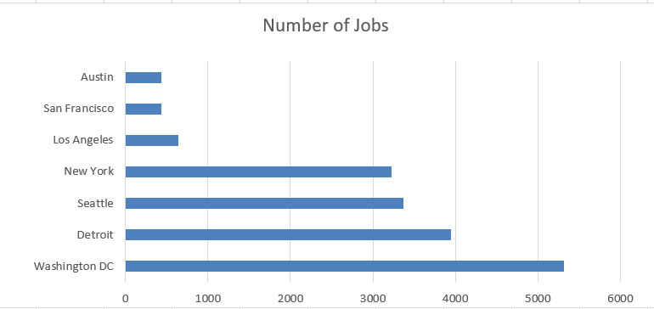
JOB POSTINGS
Washington DC and Detroit have the highest number of job postings.
Tech jobs are concentrated in major cities.

Slide 20
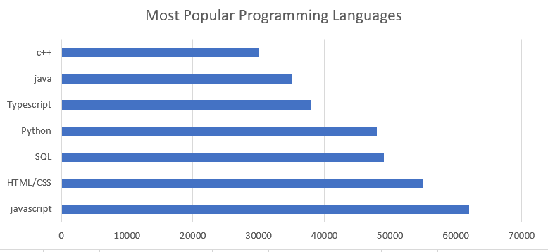
POPULAR LANGUAGES
JavaScript and Python are the most popular programming languages.
SQL and HTML/CSS are widely used by developers.
Multi-language programming skills are in high demand.

